Slide 1
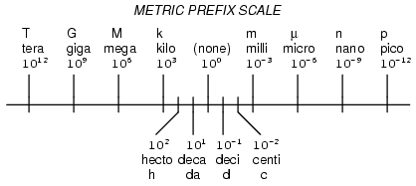
Dimensional Analysis

Slide 2
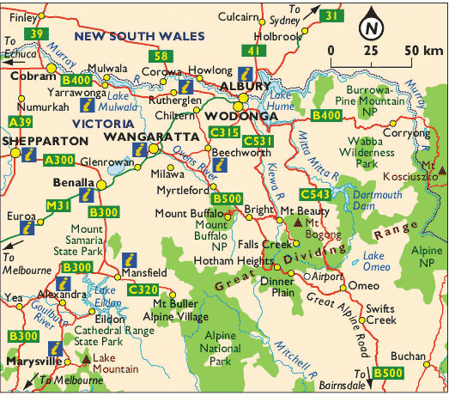
What is Dimensional Analysis?
Have you ever used a map?
Since the map is a small-scale representation of a large area, there is a scale that you can use to convert from small-scale units to large-scale units
for example, going from cm to km.
Ex: 3 cm = 50 km
Have you ever been to a foreign country?
One of the most important things to do when visiting another country is to exchange currency.
For example, 1 Canada Dollar equals about 0.75 United States Dollar
Dimensional analysis is a problem-solving method that uses the idea that any number or expression can be multiplied by one without changing its value.
- It is used to go from one unit to another.

Slide 3
How Does Dimensional Analysis Work?
A conversion factor, or a fraction that is equal to one, is used, along with what you’re given, to determine what the new unit will be.
The previous slide stated that 3 cm equals 50 km on the map or that $1 CAN equals 0.75 US.
If we write these expressions mathematically, they would look like:
Other examples:
60 s = 1 min
60 min = 1 h
24 h = 1 day
3 cm = 50 km
$1 CAD = 0.75 US
You can write any conversion as a fraction. Be careful how you write that fraction. For example, you can write 60 min = 1 hr
as 60min or 1 hr
1 hr 60 min

Slide 4
Example
How many minutes are in 2.5 hours?
1 hr = 60 min
60 min or 1 hr
1 hr 60 min
Conversion factor
2.5 hr
cancel
x 60 min
1 hr
= 150 minutes

Slide 5
Dimension Analysis Steps
Start with the given value.
Write the multiplication symbol.
************Choose the appropriate conversion factor.*************
The problem is solved by multiplying the given data & their units by the appropriate unit factors so that the desired units remain.
Remember, cancel like units.
Suppose there are 12 slices of pizza in one pizza. How many slices are in 7 pizzas?
84 slices
7 pizzas
12 slices
1 pizza
X
=

Slide 6
Let’s try some examples together…
How many cm is 3.5 hm?
Given: 3.5 hm
Want: # cm
Conversion: 10000 cm = 1 hm
35000 cm
3.5 hm
10000 cm
1 hm
X
=

Slide 7
Let’s try some examples together…
How many km is 14258 m?
Given: 14258 meters
Want: # km
Conversion: 1000 m = 1 km
14.258 km
14258 m
1 km
1000 m
X
=

Slide 8
Let’s try some examples together…
How old are you in days?
Given: 16 years
Want: # of days
Conversion: 365 days = one year
5840 days
16 years
365 days
1 year
X
=

Slide 9
Equalities
State the length of the green line in two different units…
1.0 in.
2.54 cm

Slide 10
Let’s try some examples together…
There are 2.54 cm in one inch.
How many inches are in 17.3 cm?
Given: 17.3 cm
Want: # of inches
Conversion: 2.54 cm = one inch
6.81 inches
17.3 cm
1 inch
2.54 cm
X
=
Be careful!!! The fraction bar means divide.

Slide 11
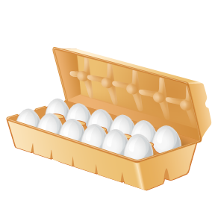
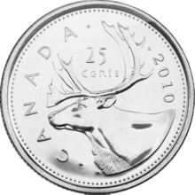
Now, you try…
Determine the number of dozen of eggs if you have 276 eggs.
You have $7.25 in your pocket in quarters. How many quarters do you have?
276 eggs 1 dozen
12 eggs
X
= 23 dozens
7.25 dollars 4 quarters
1 dollar
X
= 29 quarters

Slide 12
Multiple-Step Problems
Most problems are not simple one-step solutions. Sometimes, you will have to perform multiple conversions.
Example: How old are you in hours?
Given: 16 years
Want: # of hours
Conversion #1: 365 days = one year
Conversion #2: 24 hours = one day
16 years
1
365 days
1 year
24 hours
1 day
X
X
140,160 hours
=

Slide 13
Learning Check
How many seconds are in 1.4 days?
Unit plan: days hr min seconds
1.4 days x 24 hr
1 day
x 60 min
1 hr
x 60 s
1 min
= 120960 s
or 1.2096 x10⁵ s

Slide 14
Combination Units
Dimensional Analysis can also be used for combination units.
Like converting km/h into cm/s.
Write the fraction in a “clean” manner:
km/h becomes km
h
Example: Convert 0.083 km/h into m/s.
Given: 0.083 km/h
Want: # m/s
Conversion #1: 1000 m = 1 km
Conversion #2: 1 hour = 60 minutes
Conversion #3: 1 minute = 60 seconds
0.083 km
1 hour
1000 m
1 km
1 hour
60 min
1 min
60 sec
= 0.023 m
sec
X
X
X

Slide 15
Combination Units
Convert 0.25 m/min into cm/day.
Given: 0.25 m/min
Want: # cm/day
Conversion #1: 1 m = 100 cm
Conversion #2: 1 hour = 60 minutes
Conversion #3: 1 day = 24 hours
0.25 m
1 min
100 cm
1 m
= 36000 cm
day
60 min
1 hour
24 hour
1 day
X
X
X

