Slide 1
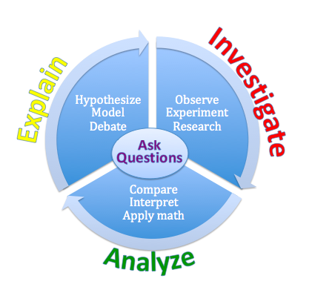
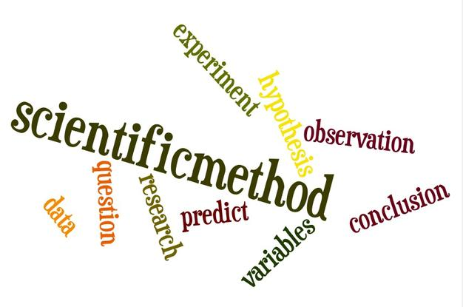
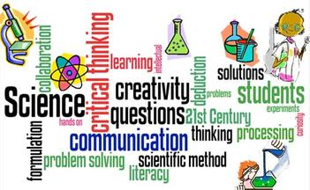
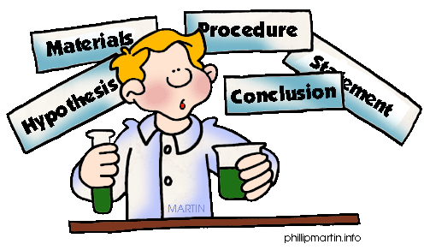
SCIENCE SKILLS

Slide 2
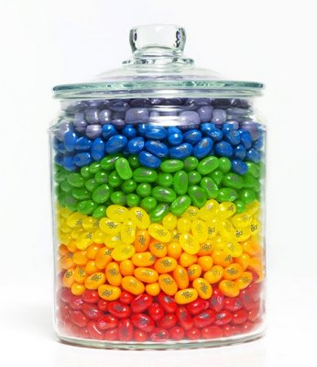
Estimation
Laboratory Skills
Day 1
To roughly determine an object’s measurements by comparing to previously measured standards
Example 1:
The earth weighs about 6 x 10²⁴ kg.
Example 2:
The number of jelly beans in the jar.

Slide 3
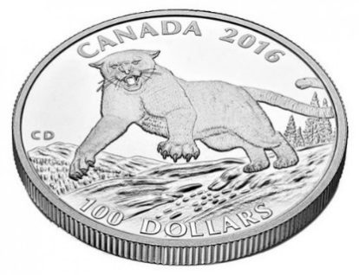
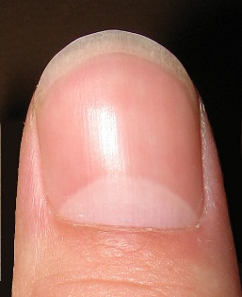
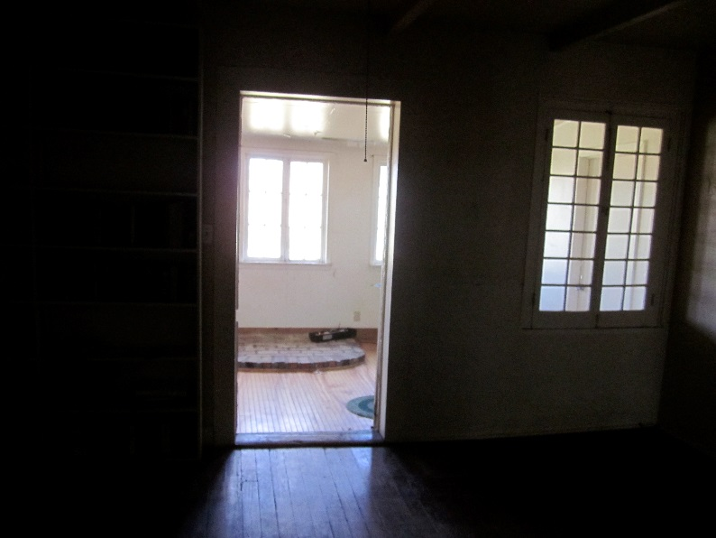
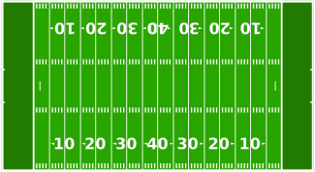
Meters Estimates
Meters measures length or distance
One millimeter is about the thickness of …….
One centimeter is about the width of …….
One meter is about the width
One kilometer is about …….
x6 or ~6 city blocks

Slide 4
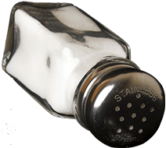
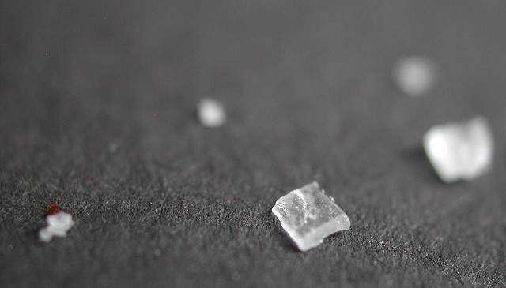
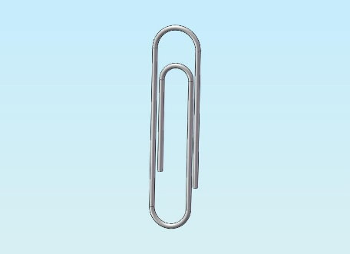
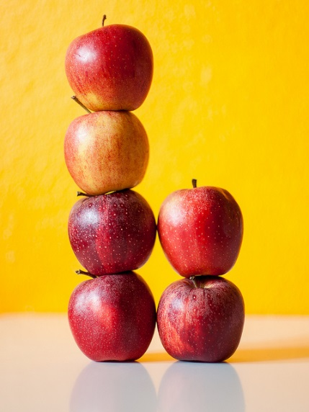
Gram
Grams are used to measure mass or the weight of an object.
1 milligram weighs about as much as…..
1 gram weighs about as much as a small paper clip.
1 kilogram weighs about as much as….

Slide 5
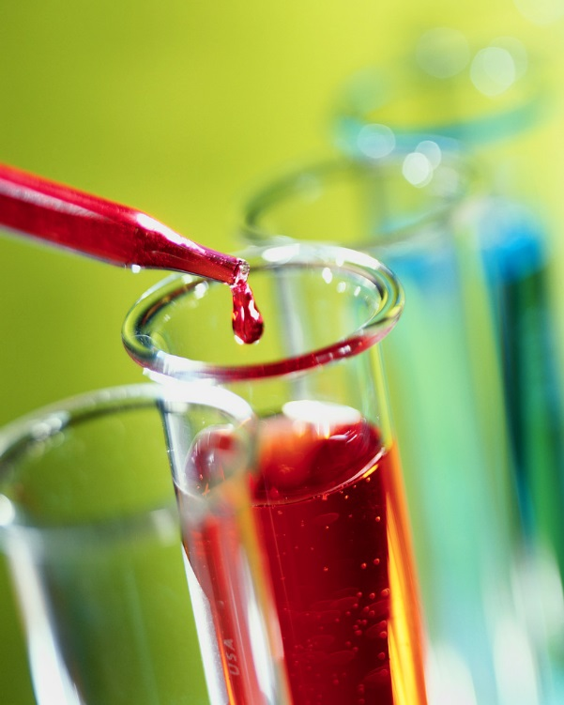
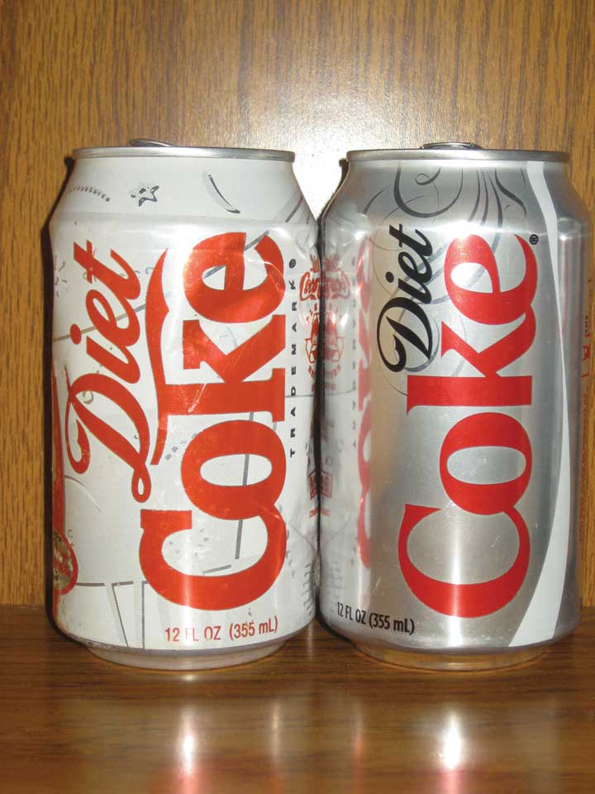
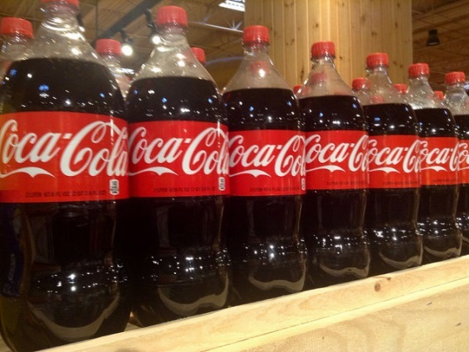
Liters
Liters measure liquids or capacity.
1 milliliter is about the amount of …….
1 liter is about ……
A kiloliter would be about….
500 2-liter bottles of pop

Slide 6
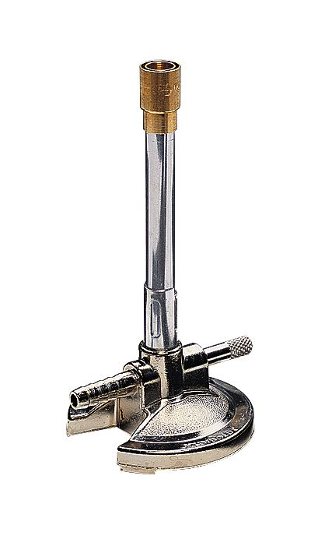
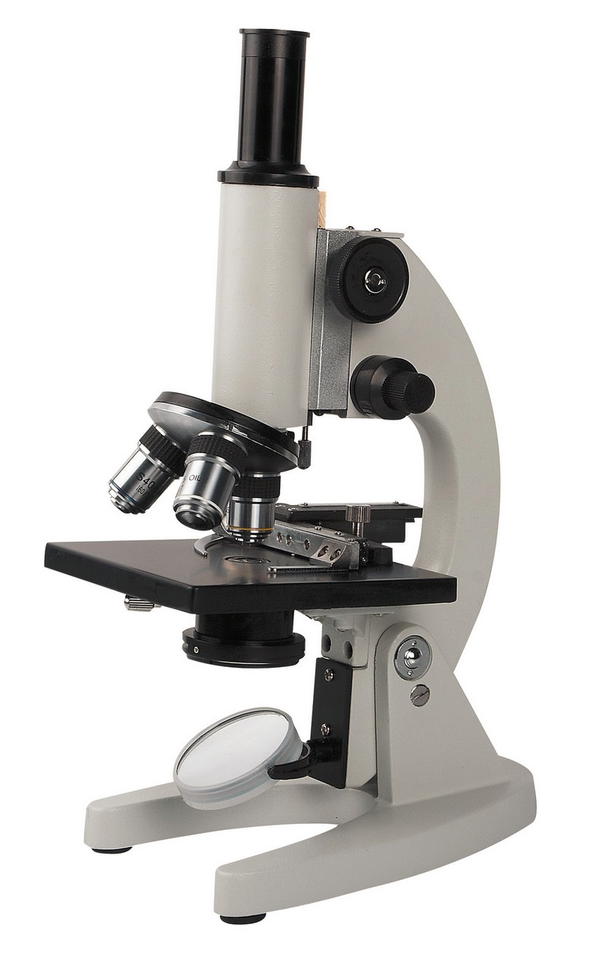
Laboratory Skills
Measurement
Gives exact information about an object’s characteristics.
Example: A candle is 12 cm long.
Metric Common Base Units
Measurement | Base unit | Symbol
Length | Meters | m
Volume | Liters | L
Mass | Grams | g
Time | Seconds | s

Slide 7
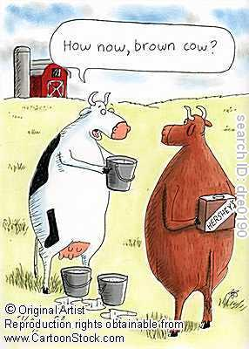
Metric System
The Story of
King Henry

Slide 8
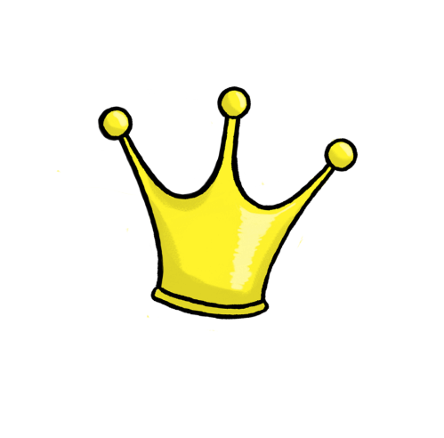
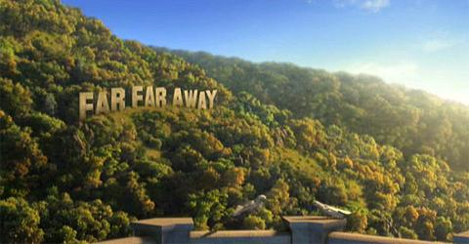
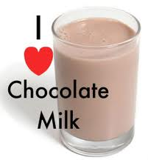
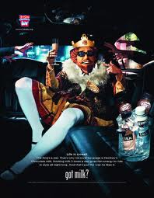
Once upon a time in a faraway land there lived a king who loved chocolate milk. His name was King Henry.

Slide 9
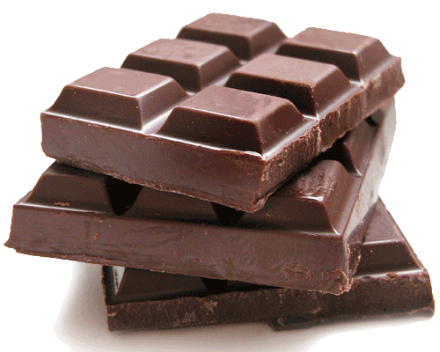
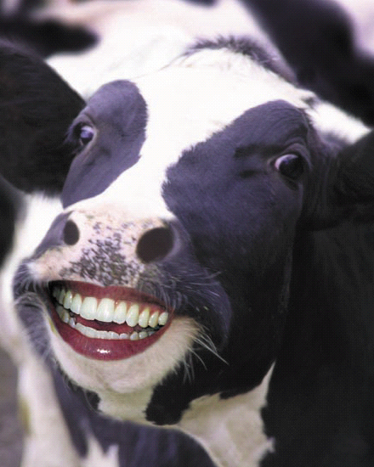
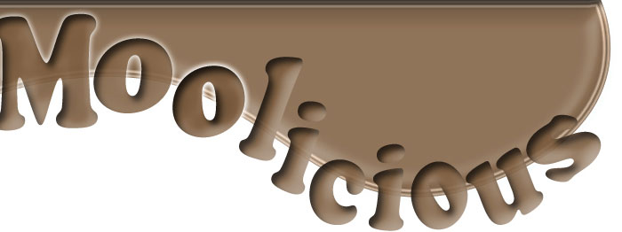
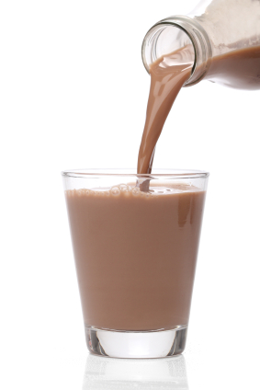
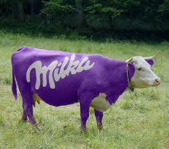
Throughout his kingdom, King Henry made sure that all of the cows were fed great supplies of chocolate to continue to provide him with his beloved chocolate milk drink.

Slide 10
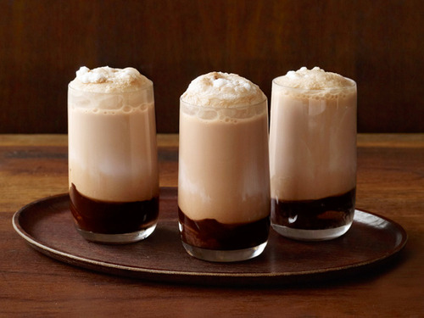
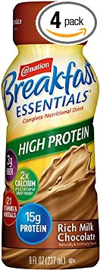
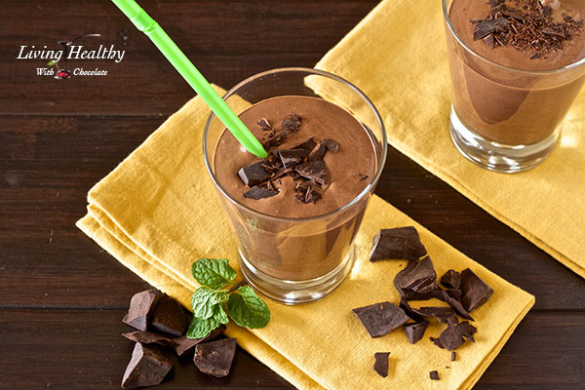
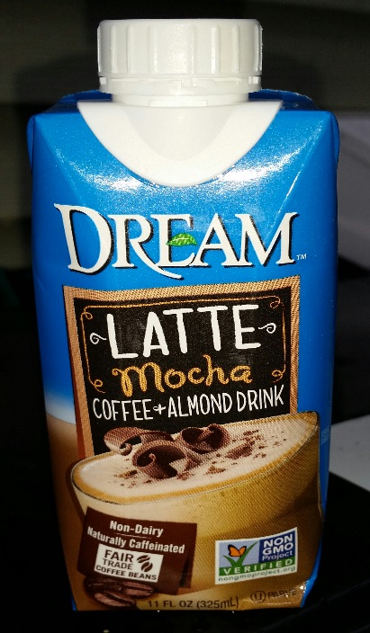
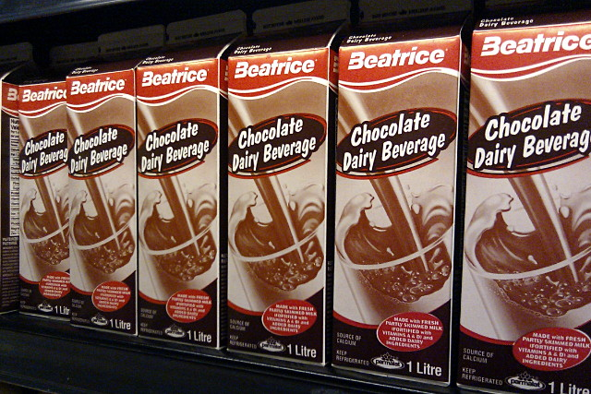
King Henry drank chocolate milk with his breakfast. He drank chocolate milk with his lunch. He drank chocolate milk with his dinner. He even drank chocolate milk for his bedtime snack. King Henry drank chocolate milk by the liters!

Slide 11
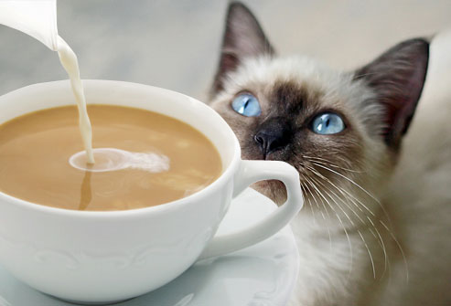
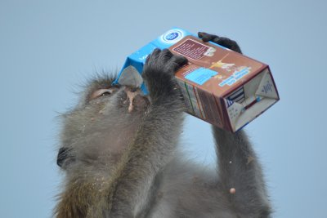
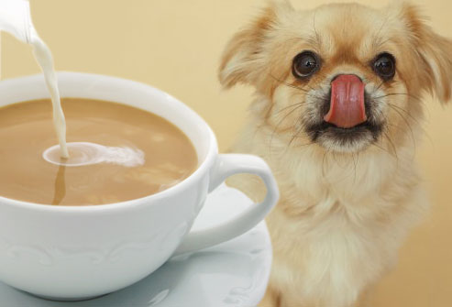
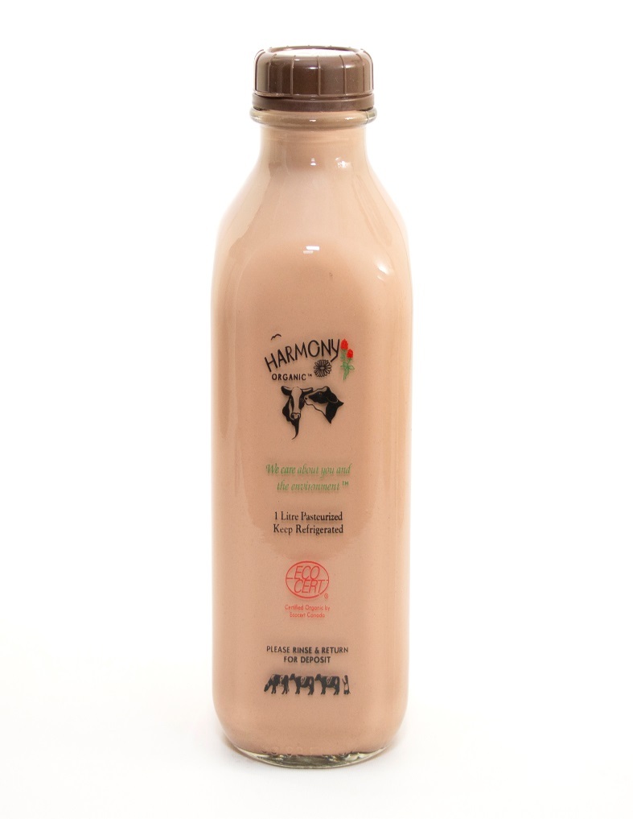
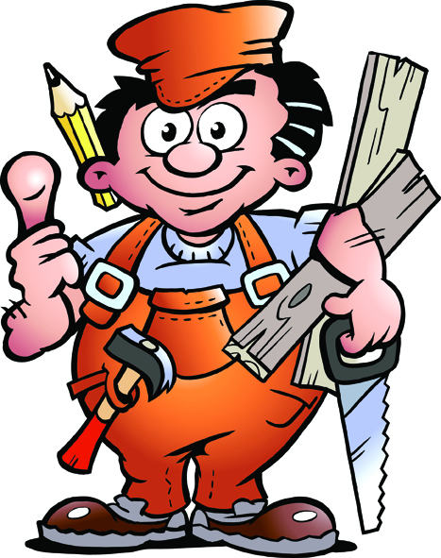
King Henry wanted all living creatures in his kingdom to enjoy chocolate milk as much as he enjoyed chocolate milk. However, a liter was not the best serving size for every creature. The Royal Carpenter was called for and the command was given for new serving vessels to be created to fit every creature in the kingdom.

Slide 12
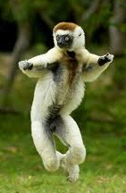
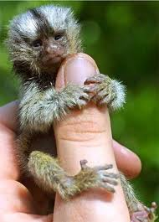
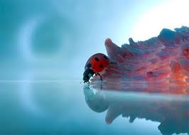
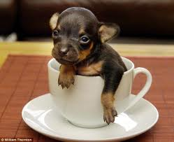
For the creatures smaller than the king, the Royal Carpenter designed deciliters that were 1/10th the size of a liter, centiliters that were 1/100th the size of a liter, and milliliters that were 1/1000th the size of a liter. The milliliters were just right for the Royal Beetles and Bugs of the kingdom.

Slide 13
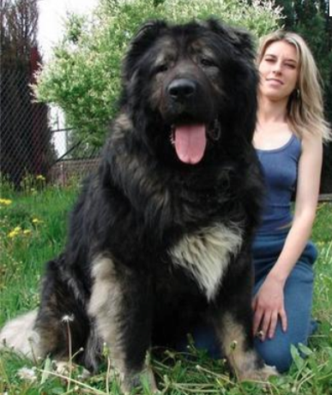
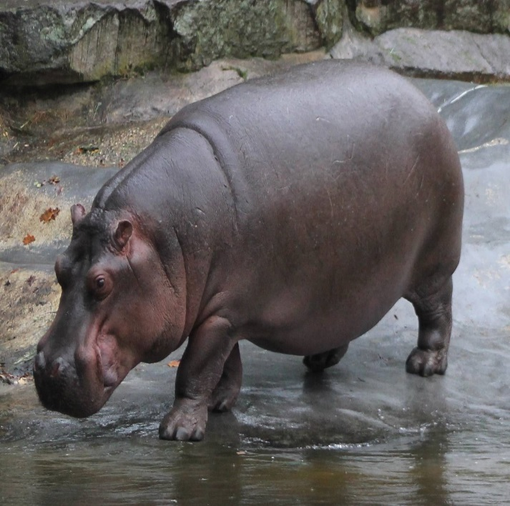
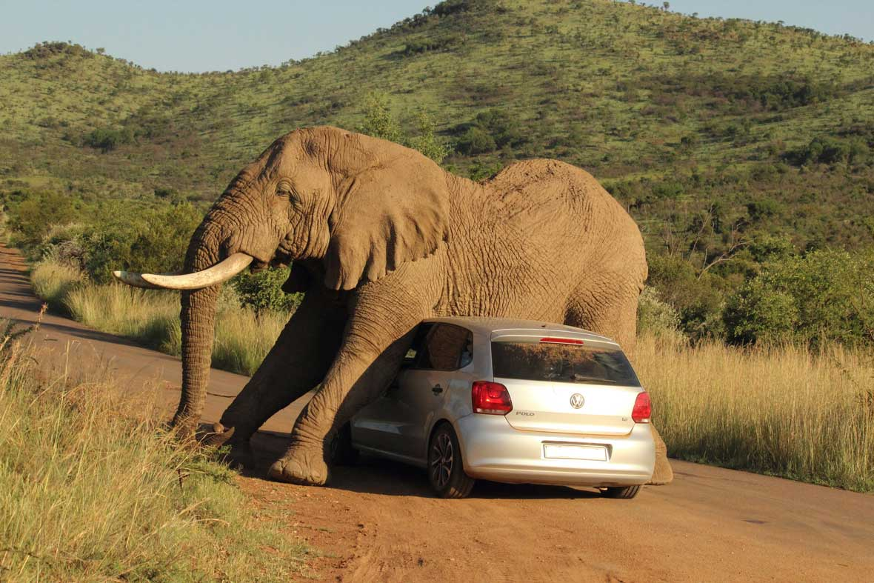
For the creatures greater than the king, the Royal Carpenter designed dekaliters that were 10 times the size of a liter, hectoliters that were 100 times the size of a liter, and kiloliters that were 1000 times the size of a liter. The kiloliters were just right for the Royal Giants of the kingdom.

Slide 14
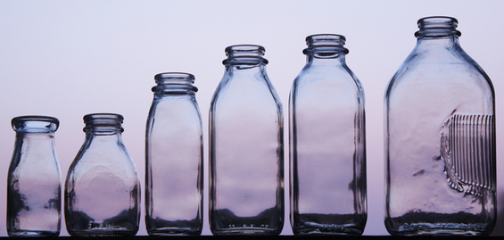
The Royal Carpenter lined the vessels up from largest to smallest to show the king. The king’s vessel was in the center of the line, for the king was the center of the kingdom.
kiloliter hectoliter dekaliter liter deciliter centiliter milliliter

Slide 15
King Henry loved the new vessels that were designed for all of the living creatures in his kingdom. The Royal Carpenter explained that the sizes increased and decreased from the king’s liter, the original unit of measurement, by multiples of ten. He explained how to convert between the sizes by multiplying by ten or dividing by ten.
kiloliter hectoliter dekaliter liter deciliter centiliter milliliter
1000 L 100 L 10 L 1 L 0.1 L 0.01 L 0.001 L

Slide 16
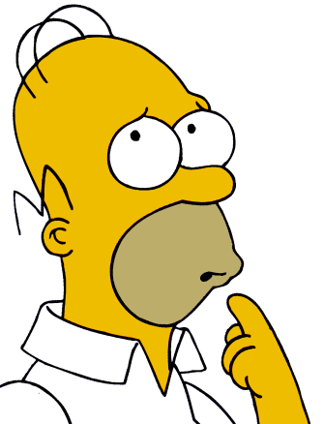
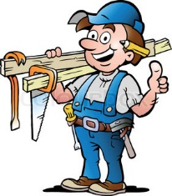
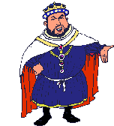
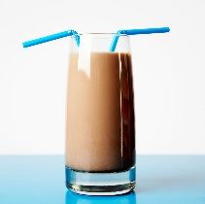
King Henry wondered how he would ever remember the order of the vessels. The Royal Carpenter said that he remembered them by thinking ‘King Henry Does Usually Drink Chocolate Milk.’ “That is exactly right!” said King Henry. “Now I shall remember the sizes of the vessels!” He took another big drink of chocolate milk and …

Slide 17
died

Slide 18
kiloliter hectoliter dekaliter liter deciliter centiliter milliliter
K H D U D C M
ING
ENRY
IED
NEXPECTLY
RINKING
HOCOLATE
ILK
1 kL 1 hL 1 daL 1 L 1 dL 1 cL 1 mL
1000 L 100 L 10 L 1 L 0.1 L 0.01 L 0.001 L

Slide 19
Metric Mania
Kangaroos
help
dingo’s
because
dingo’s
can’t
multiply
1
MAKE YOUR Own Metric Conversion Mnenomic

Slide 20
Other Prefixes Examples
Prefix | Symbol | examples
Mega | M | 1 MB = 1 000 000 bytes
Giga | G | 1 GB = 1 000 000 000 bytes
Tera | T | 1 TB = 1 000 GB
milli | m | 1000 mg = 1 g
micro | µ | 1 000 000 µg = 1 g
nano | n | 1 000 000 000 ng = 1 g

Slide 21
Laboratory Skills
Day 2
Measuring Matter: Mass and Volume
All matter has Mass and Volume
Mass & Volume can be measured directly or indirectly

Slide 22
Laboratory Skills
Mass is the amount of matter in an object
It is measured using a balance and commonly has units of milligrams, grams or kilograms.
Solids can be measured directly on a balance

Slide 23
Measuring Mass
Move the masses one notch at a time, starting with the biggest one.
If the arrow goes down, you need to move the slider backward one notch and leave it there.
Triple beam balance
Finally, slide the little mass on the front rail until the two white lines match up.
300 + 60 + 6.47
= 366.47 g
Usually, the little pointer on the small slider won’t point exactly to a line. For instance, the slider here is about halfway between 6.4 and 6.5.
In such a case, you are allowed to estimate a hundredths digit. Since it’s a little over half-way this time, you could call this one . . . 6.47.

Slide 24
521.18 grams

Slide 25
Laboratory Skills
Liquids can be measured indirectly on a balance
Powdered solids and liquids must be measured indirectly in a container, then subtracting the weight of the container.

Slide 26
Measuring Volume
Volume is the amount of space matter occupies and is usually measured in liters or milliliters
Volume of liquids can be measured directly using a graduated cylinder.
Usually, the bottom of the meniscus won’t be exactly on a line.
This one is about halfway between two lines
In this a case, you are allowed to estimate a tenths digit.
42.9 mL
Your eye should be level with the top of the liquid
You should read to the bottom of the MENISCUS
36.5 mL
Graduated Cylinder

Slide 27
Laboratory Skills
To measure the volume of solids, there are two methods:
Indirectly, usually irregularly shaped object like a rock
Fill a grad cylinder to a known volume
Add the object
Read the volume again and determine how much the reading has changed. This is the objects volume
Directly, regularly shaped object (cube, etc.)
Use formula l x w x h for a cube
Use specific formula (ie a pyramid or sphere)
Volume = length x width x height

Slide 28
The Water Displacement Method
An object is dropped into a graduated cylinder containing water and the displacement of the water is the volume of the object.
29.1
Final reading:
67.9
Final reading:
18.9
Initial reading:
63.8
10.2
Initial reading:
4.1
The object’s volume is 10.2 mL
The object’s volume is 4.1 mL

Slide 29
Volume
Measurement of the amount of space an object takes up
Measured in milliliters (mL) or cubic centimeters (cm³)
2.74 cm
Volume = height x length x width
V = h x l x w
V = 4.88 cm x 15 cm x 2.74 cm
V = 200.568 cm³
4.88 cm
15 cm
2.74
4.88

